Slide 1
Chapter Nineteen
Security

Slide 2


220-902 Objectives Covered
3.1: Identify common security threats and vulnerabilities.
3.2: Compare and contrast common prevention methods.
3.3: Compare and contrast differences of basic Windows OS security settings.
3.4: Given a scenario, deploy and enforce security best practices to secure a workstation.
3.5: Compare and contrast various methods for securing mobile devices.
3.6: Given a scenario, use appropriate data destruction and disposal methods.
3.7: Given a scenario, secure SOHO wireless and wired networks.

Slide 3
Common Prevention Methods
Physical security
Digital security
User education
Principle of least privilege

Slide 4
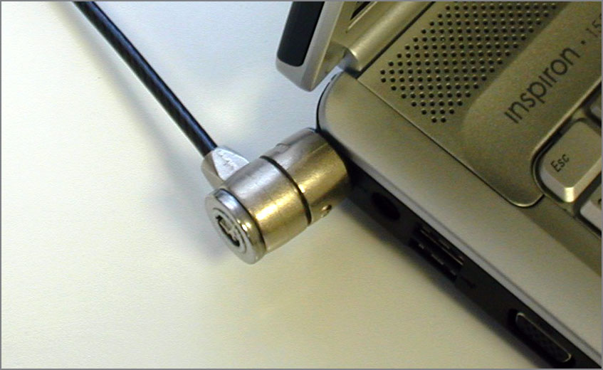
Physical Security
Notes:
A key aspect of access control involves physical barriers
multiple-barrier system – several physical barriers
Tailgating refers to being so close to someone when they enter a building that you are able to come in right behind them without needing to use a key, a card, or any other security
device

Slide 5
Physical Security
Securing Physical Documents/Passwords/Shredding
Biometrics
Badges
Key Fobs
Multifactor Authentication
Notes:
Dumpster diving is a common problem that puts systems at risk when thrown in dumpsters
Biometric devices use physical characteristics to identify the user
Key fobs are named after the chains that used to hold pocket watches to clothes. They are security devices that you carry with you; they display a randomly generated code that you can then use for authentication
Basically, the key fob is synchronized with a server and they're both seeded to generate the same sequence of pseudo-random numbers. The server knows it's you if you input the right number at the right time.
Multifactor Authentication
Anytime more than one item (factor) is needed to authenticate a user, this is known as multifactor
authentication. – e.g ATM requires a card and a pin. Microsoft download sites require you to enter your username and pswd then check your email for a specific code

Slide 6
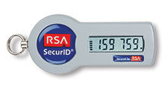
Physical Security
RFID Badges and Smart Cards
RSA Tokens
Privacy Filters
Notes:
A smart card is a type of badge or card that gives you access to resources, including buildings, parking lots, and computers. It contains information about your identity and access privileges. Each area or computer has a card scanner or a reader in which you insert your Card
Radio frequency identification (RFID) is the wireless, no-contact technology used
with these cards and their accompanying reader.
Physical tokens are anything that a user must have on them to access network resources, and they are often associated with devices that enable the user to generate a one-time password authenticating their identity. SecurID, from RSA, is one of the best-known examples
Privacy filters are either film or glass add-ons that are placed over a monitor or laptop
screen to prevent the data on the screen from being readable when viewed from the sides.

Slide 7
Common Security Threats
Social Engineering
Malware
Notes:
Social engineering
It’s a process in which an attacker attempts to acquire information about
your network and system by social means, such as talking to people in the organization.
A social engineering attack may occur over the phone, by email, or in person.
Malware
Malicious invasive software – install themselves without your consent (trick users into installing them) and spy on what you are doing. Key loggers can capture your key entries and report back to unwanted users.

Slide 8
Social Engineering
Fake emails, fake callers, unauthorized persons attempting to gain access to buildings
Shoulder Surfing
Phishing
Notes:
Social engineering
It’s a process in which an attacker attempts to acquire information about
your network and system by social means, such as talking to people in the organization.
A social engineering attack may occur over the phone, by email, or in person.
Shoulder surfing – looking over at someone's screen or using a binoculars through a window at someone using their computer and gathering information
Phishing – look like legitimate websites asking for important information such as user/password. Like a fake PayPal, bank site but with a long URL. Once you enter your credentials, the attacker can then use it to gain access to your account. Check the URL of every sight.
2 forms of phishing exist :spear phishing and whaling
Spear phishing (cuts thru defense like a spear)- the attacker uses information that the target would be less likely to question because it appears to be coming from a trusted source
Whaling (for “big” users) - whaler identifies one person from whom they can gain all of the data that they want—usually a manager or business owner
Password attacks occur when an account is attacked repeatedly. This is accomplished by
using applications known as password crackers, which send possible passwords to the
account in a systematic manner. There are several types:
1. Brute force attacks - an attempt to guess passwords until a successful guess occurs. Set password rules such as increased complexity, expiration etc.

Slide 9
MALWARE
VIRUS
Symptoms:
Flashing annoying messages
System slows down
Deleted or additional files
System unable to boot
Mysterious shut downs
Program size increase because virus has attached itself to it
Notes:
Virus is just another type of Malware (any malicious software including viruses)
Virus is more publicly used
Since viruses are a subset of malware, anti-malware software typically does everything that antivirus software does as well as identifying threats beyond just viruses
You must keep the definition database files current

Slide 10
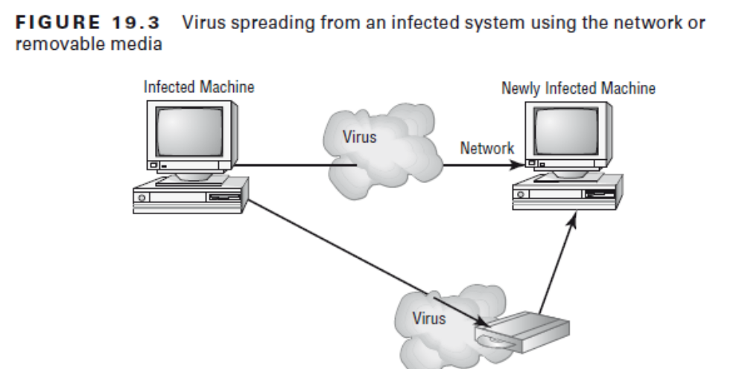
How viruses work
Notes:
Goal of virus is to render your system inoperable or Spread to other systems
Many viruses today are spread using email via attachments or removable media as shown in diagram

Slide 11
Types of Viruses
Most common:
Armored (coded to avoid detect)
Companion (attached to a prog)
Macro virus (exploits Macros)
Multipartite (multiple attacks)
Phage (has to be deleted)
Polymorphic (mutation)
Retrovirus (attack Antivirus)
Stealth (move from file to file)
Notes:
Since viruses are a subset of malware, anti-malware software
typically does everything that antivirus software does as well as identifying threats beyond just viruses
You must keep the definition database files current
Armored virus An armored virus is designed to make itself difficult to detect or analyze.
Armored viruses cover themselves with protective code that stops debuggers or disassemblers from examining critical elements of the virus. Specifically coded to make its detection difficult
The solution is to 1. Identify and 2. Educate users
Companion virus A companion virus attaches itself to legitimate programs and then
creates a program with a different filename extension. This file may reside in your system’s temporary directory. When a user types the name of the legitimate program, the companion virus executes instead of the real program.
Macro virus A macro virus exploits the enhancements (macros) made to many application programs. It can infect a program like MS Word that has mini-BASIC programming language (known as Macros) and cause it to run a sequence of actions automatically - Macro viruses are one of the fastest-growing
forms of exploitation today.
Multipartite virus A multipartite virus attacks your system in multiple ways. It may attempt to infect your boot sector, infect all of your executable files, and destroy your application files. This makes it difficult or impossible for you to correct all the problems

Slide 12
Types of Viruses
Most common:
Armored (coded to avoid detect)
Companion (attached to a prog)
Macro virus (exploits Macros)
Multipartite (multiple attacks)
Phage (has to be deleted)
Polymorphic (mutation)
Retrovirus (attack Antivirus)
Stealth (Secret movement)
Notes:
Phage virus A phage virus alters programs and databases and the only way to remove this virus is to reinstall the programs that are infected.
Polymorphic virus Polymorphic viruses change form to avoid detection. These types of
viruses attack your system, display a message on your computer, and delete files on your
system. The virus will attempt to hide from your antivirus software. Frequently, the virus
will encrypt parts of itself to avoid detection. When the virus does this, it’s referred to as
mutation.
Retrovirus A retrovirus attacks or bypasses the antivirus software installed on a computer. You can consider a retrovirus to be an anti-antivirus. Retroviruses can directly
attack your antivirus software and potentially destroy the virus definition database file.
When this information is destroyed without your knowledge, you would be left with a
false sense of security. The virus may also directly attack an antivirus program to create
bypasses for itself.
Stealth virus A stealth virus attempts to avoid detection by masking itself from applications. It may attach itself to the boot sector of the hard drive or may move themselves from file A to file B during a virus scan to avoid detection
***A signature is an algorithm or other element of a virus that uniquely identifies it***

Slide 13
Other types of Malware
Man-in-the-Middle Attacks
Worms (self replicating malware)
Trojans
Ransomware
Rootkits
Spyware
Spoofing
Zero-Day Attack
Zombie/Botnet
Notes:
Malware
***Malicious invasive software ***
Man-in-the-middle attacks – clandestine software hiding between a server and a user intercepting information each is trying to send to the other and sending them back and fourth. The systems administrator cannot tell that there has been an attack because the info is valid. The man-in-the-middle software may be recording information for someone to view later, altering it, or in some other way compromising the security of your system and session. The software could be outside intercepting packets (aka TCP/IP hijacking)– WPA2 is a way to prevent this.
Worms are malware that self replicate on your network and can take over many PC’s quickly
The primary method of preventing the propagation of malicious code involves the use of
antivirus software (worms, viruses, Trojan horses)
Trojans like the Trojan Horse story of the Greeks, it tricks you into running an application that is advertised as doing one thing but then do something else like open the door for worms and viruses to come in. They come under the guise of another program.
Ransomware – often delivered through Trojan Horses, hold your data until you pay some money to the bad folks – encrypts the files and forces you to pay for the decryption key.
Rootkits – malicious software that are notorious for hiding things from the OS by retaining administrative level access. They hide in the OS (in plain sight like System32 folder) and modify parts of the kernel. The best defense you have is to monitor what your system is doing and catch the rootkit in the process of installation.
Spyware - Rather than self-replicating, like viruses and worms, spyware is spread to machines by users who inadvertently ask for it. The users often don’t know they have asked for it but have done so by downloading other programs, visiting infected sites, and so on. Spyware then monitors your activity and sends unsolicited adware.
Spoofing attack is an attempt by someone or something to masquerade as someone else.
3 Most Popular spoofing attacks are: IP spoofing, ARP spoofing, and DNS spoofing
1. IP spoofing, the goal is to make the data look as if it came from a trusted host when it didn’t (thus spoofing the IP address of the sending host).
2. With ARP spoofing (also known as ARP poisoning), the media access control (MAC) address of the data is faked. Router can then be fooled to transmit data thinking it’s from a valid source.
3. With DNS spoofing, the DNS server is given information about a name server that it thinks is legitimate when it isn’t. This can send users to a website other than the one to which they wanted to go, reroute mail, or do any other type of redirection for which data from a DNS server is used to determine a destination
Another DNS weakness is domain name kiting. When a new domain name is
issued, there is technically a five-day grace period before you must pay for it.
Those engaged in kiting can delete the account within the five days and reregister
it, allowing them to have accounts that they never have to pay for
Zero-Day Attack
When a hole is found in a web browser or other software, and attackers begin exploiting it the very day it is discovered by the developer (bypassing the one-to-two-day response time that many software providers need to put out a patch once the hole has been found)
Botnet - describes malicious software running on a zombie (infected computer) and under the control of a bot-herder. Bots, are a form of software that runs automatically and autonomously.
(For example, Google uses the Googlebot to find web pages)

Slide 14
Workstation best practices
Strong Passwords
Require Passwords & Expiration
Account Management
Data Loss Prevention (DLP)
Notes:
Passwords:
should be as long as possible (10 characters minimum recommended by experts)
a total of 62 characters available with which to construct a password
((A=26) + (a=26) + (0-9)) = 62
Therefore a 4 character password = 62x62x62x62 OR 62^4 = 14 Million password possibilities
4 character password (lowercase only) = 26^4 = 456,000 combinations
10 character password 62^10 – huge possibilities
Requiring Passwords and Expiration
Require for all accounts and enforce expiration policy (6mths or so)
Also have passwords for BIOS and UEFI (unified extensible firmware interface)
Account Management
Allows restricting user permissions, setting login time restrictions, disabling the guest account, locking an account after a certain number of failed attempts, configuring a screen lock..etc.
Data Loss Prevention
Data loss prevention (DLP) systems monitor the contents of systems (workstations, servers, and networks) to make sure that key content is not deleted or removed. They also monitor who is using the data (looking for unauthorized access) and transmitting the data. DLP systems share commonalities with network intrusion prevention systems. Tripwire and Mydlp are ideal examples.
Designated DLP solutions detect and prevent unauthorized attempts to copy or send sensitive data, intentionally or unintentionally, without authorization, mainly by personnel who are authorized to access the sensitive information. In order to classify certain information as sensitive, these solutions use mechanisms, such as exact data matching, structured data fingerprinting, statistical methods

Slide 15
Solutions
Antivirus and Anti-malware Software
Firewalls
Antispyware
Directory Permissions
User Education/AUP
Principle of Least Privilege
Email Filtering
Notes:
Since viruses are a subset of malware, anti-malware software typically does everything that antivirus software does as well as identifying threats beyond
just viruses
You must keep the definition database files current

Slide 16
Firewalls
Packet filter - passes or blocks traffic
Proxy firewall – intermediary between networks
Stateful inspection firewall
Notes:
Firewalls
Stand-alone/personal/host-based or network-based firewalls-included with hardware such as Routers (layer 3)
The basic purpose of a firewall is to isolate one network from another
Come as Appliances –i.e. freestanding devices that operate in a largely self-contained
manner, requiring less maintenance and support than a server-based product
Firewalls function as one or more of the following:
■■ Packet filter - passes or blocks traffic to
specific addresses based on the type of application and the port used. E.g. allow port 80 and block port 23
■■ Proxy firewall - Proxy firewalls are used to process requests from an
outside network; the proxy firewall examines the data and makes rule-based decisions
about whether the request should be forwarded or refused.
A proxy firewall typically uses two network interface cards (NICs). This type of firewall
is referred to as a dual-homed firewall. One of the cards is connected to the outside network, and the other is connected to the internal network.
■■ Stateful inspection firewall - Most of the devices used in networks don’t keep track of how information is routed or used. After a packet is passed, the packet and path are forgotten. In stateful inspection (or stateful packet filtering), records are kept using a state table that tracks every communications channel and can deny packets that were not requested from the internal network

Slide 17
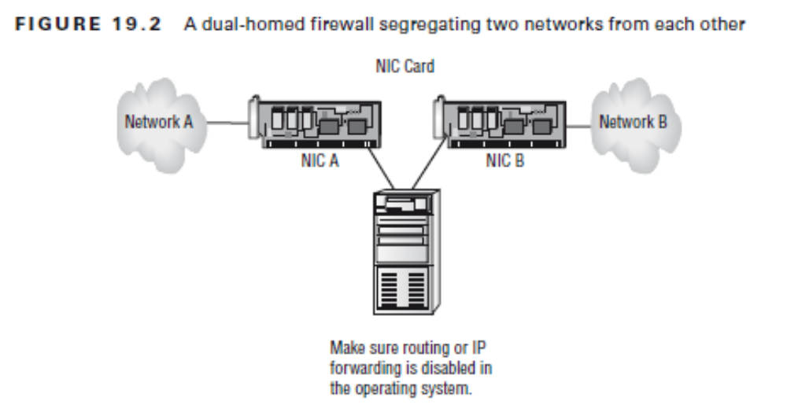
Dual-Homed Firewall

Slide 18
Solutions (contd)
Antispyware
Directory Permissions
User Education/AUP
Principle of Least Privilege
Email Filtering
Notes:
Anti-spyware – spyware exist almost primarily for commercial gain and affect Microsoft systems more. Windows Defender and Security Essentials were released (free with OS) to combat them.
Directory Permissions – NTFS file permission built in to the file system. Username and Password.
User Education/Acceptable Use Policy – Educate users in what they should and shouldn’t open. AUP describes how employees can use and company resources and consequences for misuse.
Principle of Least Priviledge - When assigning permissions, give users only the permissions they need to do their work and no more
Email Filtering - Filtering Spam is important before they get to the user. It is stopped at the gateway before it gets to the user.

Slide 19
Virtual Private Network
A VPN is a private network connection (often secure) that occurs through a public network (unsecure)
Hardware or software on client/server
VPN concentrator encrypts data before it gets to a VPN client.

Slide 20
Workstation Best Practices
Set strong passwords.
Require passwords.
Restrict user permissions.
Change default usernames.
Disable the guest account.
Make the screensaver require a password.
Disable autorun functionality.

Slide 21
Windows Users and Groups
Administrator(s)
Power User
Guest
User
Notes:
These groups are created by default:
The administrator account is the most powerful of all: it has the power to do everything
from the smallest task all the way up to removing the operating system
Power Users - members in this group are given read/write permission to the system,
allowing them to install most software but keeping them from changing key operating
system files. As such, it would be a good group for those who need to test software (such as programmers) and junior administrators
The guest account is created by default (and should be disabled). They have the same rights as Users except they can’t get to log files. The best reason to make users members of the Guests group is to
access the system only for a limited time
Standard User - Members of this group have read/write permission to their own profile. They cannot modify system-wide settings

Slide 22
Share Permissions vs NTFS
Share permissions apply only when a user is accessing a file or folder through the network.
Local permissions and attributes are used to protect the file when the user is local.
Share permissions are directory level only while NTFS permissions extend to the Files
Notes:
With FAT and FAT32, you do not have the ability to assign “extended” or “extensible” permissions, and the user sitting at the console effectively is the owner of all resources on the
system. As such, they can add, change, and delete any data or file.
NTFS permissions are able to protect you at the file level.
Share permissions can be applied to the directory level only

Slide 23
NTFS Permissions
Allow, Not Allow, Deny
Move vs Copy
File Attributes (Full control, Modify, Read and Execute, List Folder Contents, Read and Write)
Notes:
Allow, Not Allow, Deny
Allow – the group members can perform that specified action
Not allow – does not allow user to perform that action
Deny – On top of not allowing it also prohibits the user and trumps all other permissions
Inherent - Permissions set on a folder are inherited down through subfolders, unless otherwise changed
Cummulative - if a user is a member of a group that has Read permission and a member of a group that has Write permission, they effectively have both
Read and Write permission.
Move vs Copy
Copy creates a new entity, move simply relocates.
Copy – ignores permission levels created on the original file
Move – attempts to keep the permissions
**Move from NTFS to FAT32 loses permissions while the reverse adds new permissions

Slide 24
NTFS Directory Permissions
Full Control
Modify
Read & Execute
List Folder Contents
Read
Write
Notes:
(FAT) file system was relatively stable if the systems that were controlling it kept running, it didn’t do well when the power went out or the system crashed unexpectedly
NTFS has transaction tracking system that allows Windows NT to back out of any disk operations that were in progress when it crashed or lost power
With NTFS, files, directories, and volumes can each have their own security; tracked using Active Control Lists (ACLs).
ACLs specify permission levels – Read, Write, Execute etc
Microsoft strongly recommends that all network shares be established using NTFS.
***It’s possible to convert from FAT32 to NTFS without losing data, but you can’t do the operation in reverse (you would need to reformat the drive)***

Slide 25
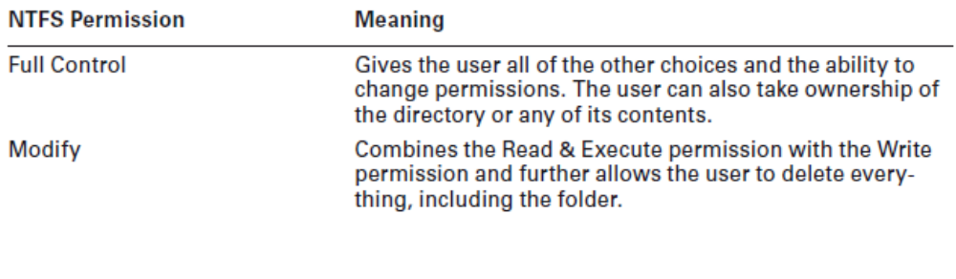
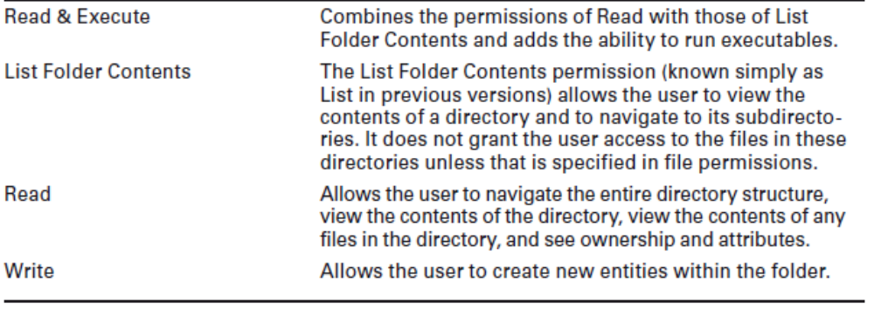
NTFS Directory Permissions

Slide 26
NTFS File Permissions
Full Control
Modify
Read & Execute
Read
Write

Slide 27
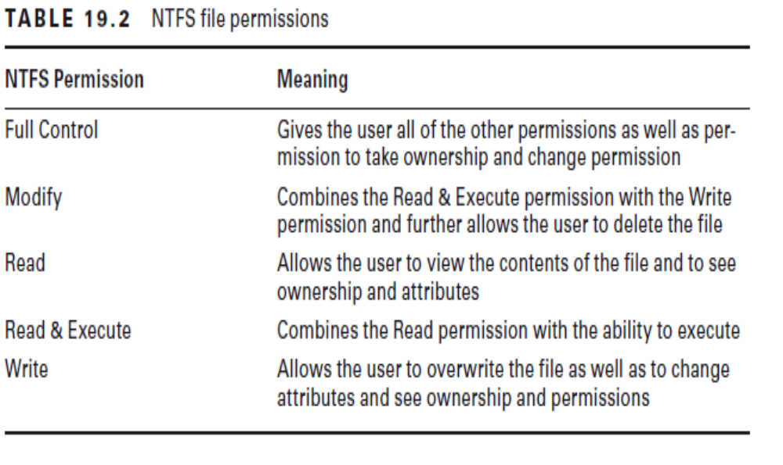
NTFS File Permissions

Slide 28
Administrative Shares vs. Local Shares
Hidden Attribute
Single Sign-on
Bitlocker and Bitlocker To Go
Encrypting File System
Notes:
Administrative shares are created on servers running Windows on the network for administrative Purposes – they always end with a dollar sign ($) to make them hidden
Hidden attribute - they files with this attribute don’t appear when
a user displays a directory listing. You should not change this attribute on a system file
unless absolutely necessary. System files are required for the OS to function. If they are visible,
users might delete them (perhaps thinking that they can clear some disk space by deleting
files that they don’t recognize).
single sign-on (SSO gives users access to all of the applications and systems that they need when they log on – Active Directory
BitLocker allows you to use drive encryption to protect files—including those needed for startup and logon. Bitlocker To Go is for removable drives and prevents access from unauthorized users

Slide 29
Mobile Device Security
Screen locks
Remote wipes
Device locator applications
Remote backup
Notes:
Screen Locks
Apple and Android mobile devices include a requisite passcode locking mechanism that
is off by default, but the user on the go is encouraged to enable a passcode lock.
Biometric Authentication – Include fingerprint lock, face lock, or swipe lock
See Ex 19.2 – Setting Passcode on iPhone
See Ex 19.3 – Setting Passcode on Android
Remote Wipes and Locator Applications
Find My iPhone that, together with iCloud, allows multiple
mobile devices and Macs to be located if powered on and connected to the Internet
Allows Remote Lock – for lost devices
Remote wipe – can return the system to factory default remotely

Slide 30
Destruction and Disposal Methods
Low-Level Format vs. Standard Format
Hard Drive Sanitation and Sanitation Methods
Physical Destruction (shred, drill/hammer/degaussing, incineration)
Notes:
Low-Level Format vs. Standard Format
A standard format, accomplished
using the operating system’s FORMAT utility (or similar), can mark space occupied by files as available for new files without truly deleting what was there; it doesn’t guarantee that the information isn’t still on the disk and recoverable
A low-level format (typically only accomplished in the factory) can be performed on the
system, or a utility can be used to completely wipe the disk clean. This process helps ensure that information doesn’t fall into the wrong hands - must be performed even before a drive can be partitioned
For exam - most forms of formatting included with the operating system do not actually erase the data completely
Hard Drive Sanitation and Sanitation Methods
Advanced Encryption Standard (AES) cryptography are often built into the Hard drive
HDDERASE can also be run but does not guarantee that files can’t be retrieved
Physical Destruction
The only surefire method of rendering the hard drive contents completely eradicated
Shred, Drill/Hammer/Electromagnetic (degaussing), Incineration)
Degaussing involves applying a strong magnetic field to initialize the media (this is also referred to
as disk wiping).
Incineration (fire)
A certificate of destruction (or certificate of recycling) may be required for audit purposes.
Such a certificate, usually issued by the organization carrying out the destruction

Slide 31
Securing a SOHO Network
Change the default SSID.
Disable SSID broadcasts.
Disable DHCP or use reservations.
Use MAC filtering.
Use IP filtering.
Use strongest security available on the access point.
Change the static security keys every two to four weeks.
Limit the user accounts that can use wireless connectivity.
Use a pre-authentication system, such as RADIUS.
Use remote access filters.
Use IPSec tunnels over the wireless links.
Turn down the signal strength.
Remove wireless access from your LAN..
Antenna/Access point placement – limit reach or network
Radio Power levels – Some APs use power to limit reach

